Slide 1
Army 101
An Introduction to the United States Army
1 April 2024 / The Appearance of U.S. Department of Defense (DoD) visual information does not imply or constitute DoD endorsement.

Slide 2
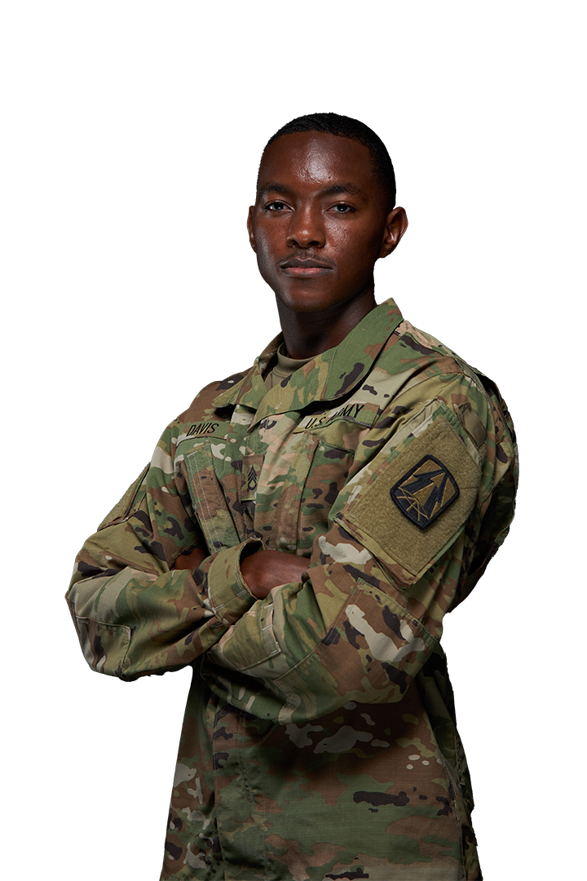

Overview
Your United States Army
The Army is older than the country it serves. Authorized by the Second Continental Congress, the Continental Army was established on 14 June 1775.
The Army:
is the oldest and largest of the military departments;
has Soldiers in every state and territory (Total Army);
is the second largest U.S. employer (Walmart is the largest);
has over 250 Military Occupational Specialties and Officer specialties; and
is the foundation of the Joint Force.
Fewer than 1% of Americans currently serve in the military. 83% of Soldiers come from families with members who have served in the military.*
* SECARMY/CSA Congressional Testimony, 2023

Slide 3
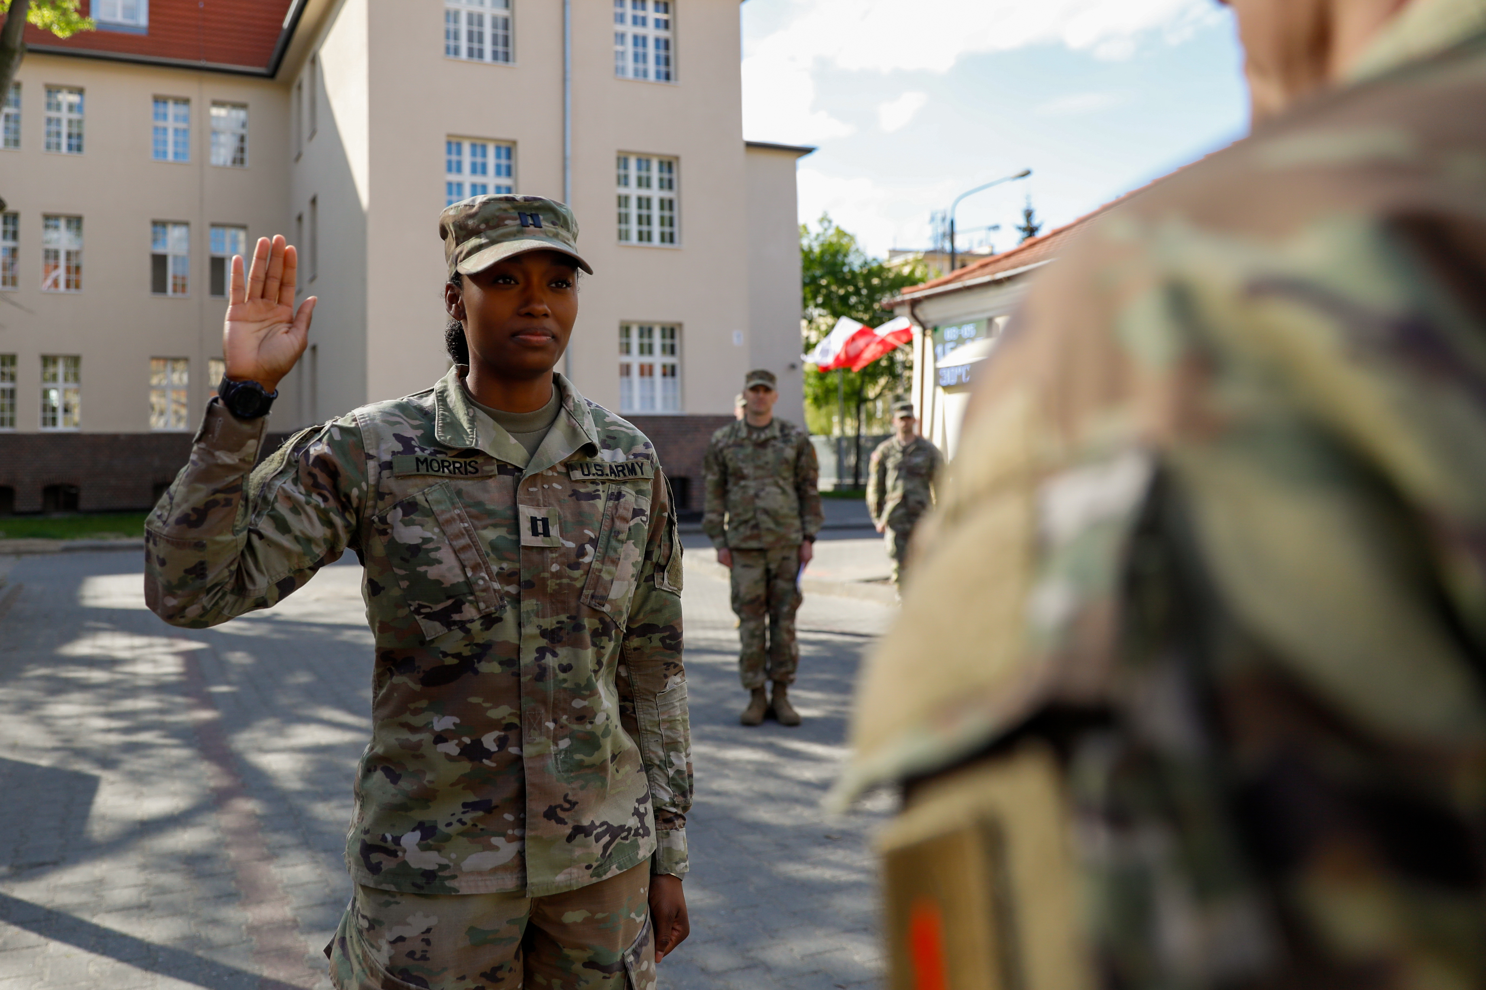
People are our Army
Soldiers serve and live by a set of seven common values:
LOYALTY
DUTY
RESPECT
SELFLESS SERVICE
HONOR
INTEGRITY
PERSONAL COURAGE
“
EVERY SOLDIER IS A VOLUNTEER
Soldiers are not in the Army;
Soldiers are the Army.
GEN Creighton Abrams
26th Chief of Staff of the Army

Slide 4









America’s Army
340,216
Pieces of equipment
951,800*
Soldiers
~65,000†
Deployed worldwide
284,344
Wheeled vehicles
26,232
Combat vehicles
82%
Male
18%
Female
20,742
MRAP vehicles
4,300
Aircraft
55% Caucasian
21% African American
16% Hispanic
5% Asian/Pacific Islander
3% Other/Unknown
4,466
Stryker vehicles
132
Watercraft
* 2025 Army FY25 Budget Overview / † SMA WEIMER CONGRESSIONAL TESTIMONY, 31 JANUARY 2024

Slide 5
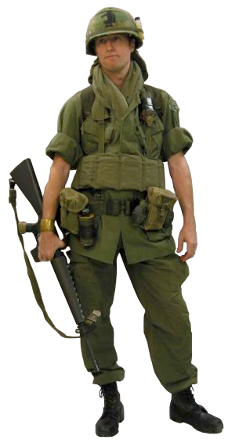
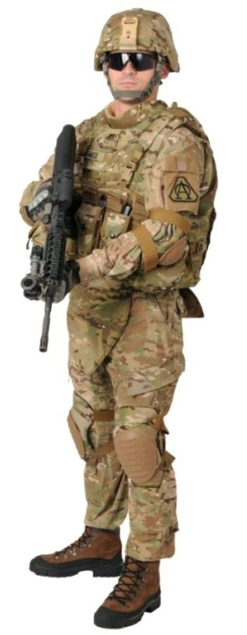
The American Soldier: Then and Now
1968
(Enlisted)
22 years old
79% high school graduates
< 1% female
21% minority
60% draftees
36% married
SGT base pay = $279/mo*
SGLI coverage = $10,000*
35 lbs of equipment ($1,856)*
Individual replacements
62% survival rate if wounded
*Not adjusted for inflation
2020
(Enlisted)
28 years old
96% high school graduates
18% female
42% minority
100% volunteers
52% married
SGT base pay = $3,001/mo
SGLI coverage = $500,000
75+ lbs of equipment ($19,454)
Unit rotations
88% survival rate if wounded

Slide 6
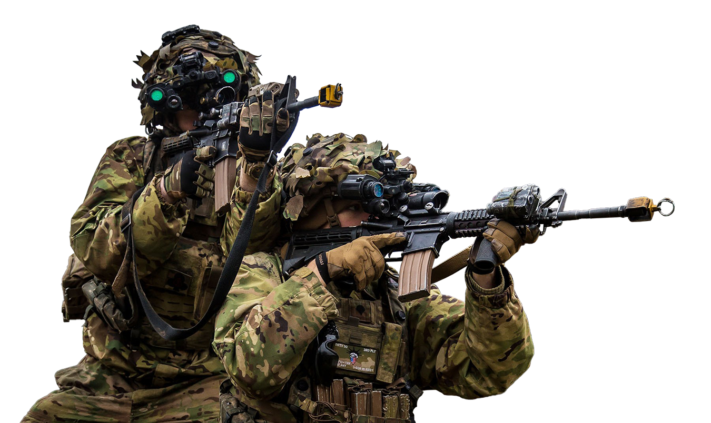
What your Army does
The U.S. Army is globally engaged with over 65,000 Soldiers deployed and 74,000 Soldiers on standby for immediate and crisis response missions.* These Soldiers conduct combat operations, deter aggression and assure our allies and partners.
Critical Enabling Capabilities
Joint and Theater logistics, including support to allies
Military training and education centers
Military healthcare – operating the majority of military hospitals
Civil engineering (Army Corps of Engineers)
Domestic natural disaster response
Administering Arlington National Cemetery
Infectious disease research
State Partnership Program
(ARNG: 88 international partnerships)
*SMA Weimer Opening Statement, House Armed Services Committee, Quality of Life Panel, 31 January 2024

Slide 7
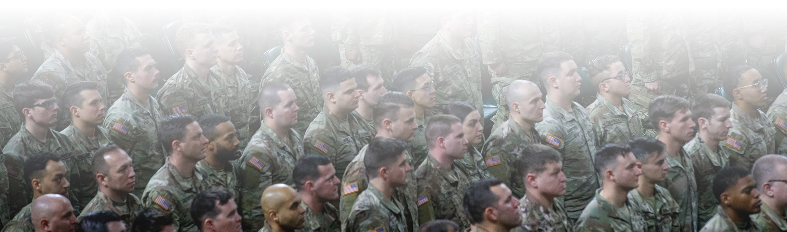
The United States Army
The U.S. Army is a total army—one Army—comprised of three components: Regular Army, Army National Guard and Army Reserve.
 | NDAA Endstrength
 | 2023 Enacted | 2024 Requested | 2025 Requested
Regular Army | 452,000 | 452,000 | 442,300
Army National Guard | 325,000 | 325,000 | 325,000
Army Reserve | 177,000 | 174,800 | 175,800
Total Army | 954,000 | 951,800 | 943,100
*2025 Army FY Budget Overview

Slide 8

Constitutionally Authorized
“
The Congress shall have the power…
To provide for the common defense...To raise and
support Armies...To provide and maintain a Navy...
To make rules for the Government and Regulation
of the land and naval forces...To declare war...And to
make laws which shall be necessary and proper for
carrying out the foregoing powers.
Article I, Section 8,
The Constitution of the United States

Slide 9

Role of the Army
Federal law, under Title 10 of the United States Code, states that the Army: “Shall be organized, trained and equipped primarily for prompt and sustained combat incident to operations on land.”
The purpose of the U.S. Army is to deploy, fight and win our nation’s wars by providing ready, prompt and sustained land dominance by Army forces across the full spectrum of conflict as part of the joint force.
Prevent: The Army deters conflict by maintaining credibility based on capacity, readiness and modernization.
Shape: The Army shapes the environment by sustaining strong relationships with other armies, building their capacity and facilitating strategic success.
Win: If prevention fails, the Army rapidly applies its combined arms capabilities to dominate the environment and win decisively.

Slide 10
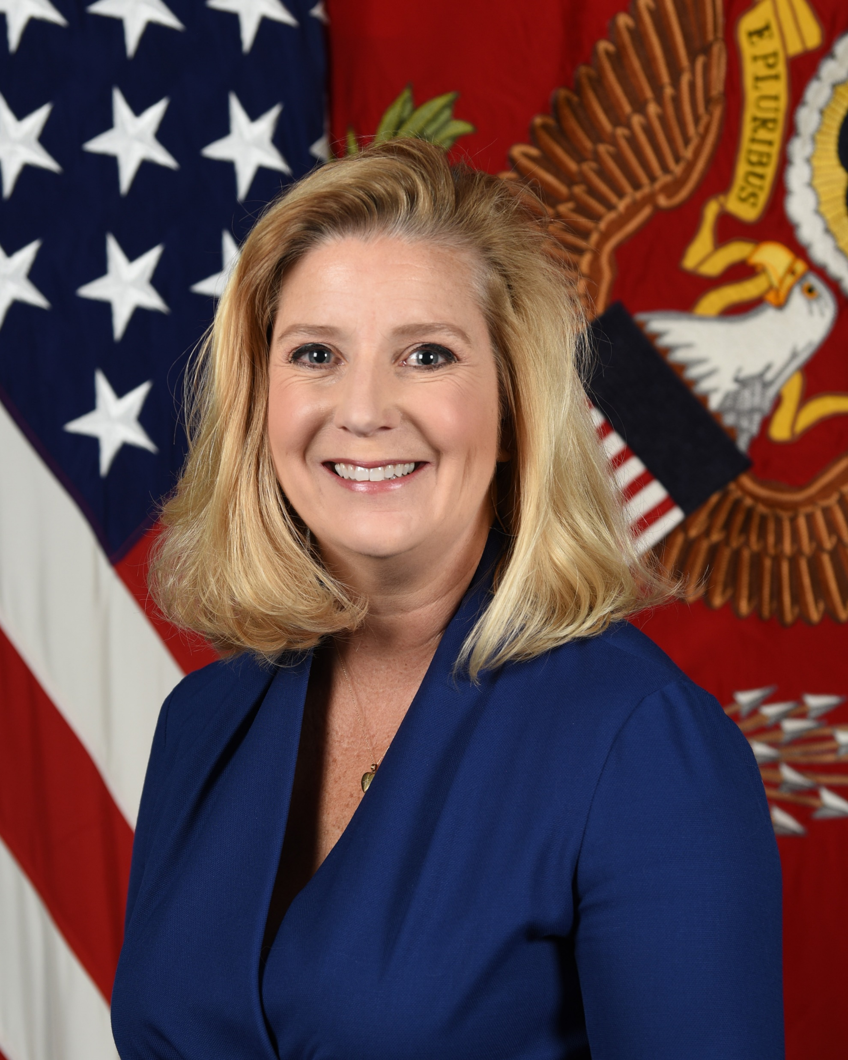
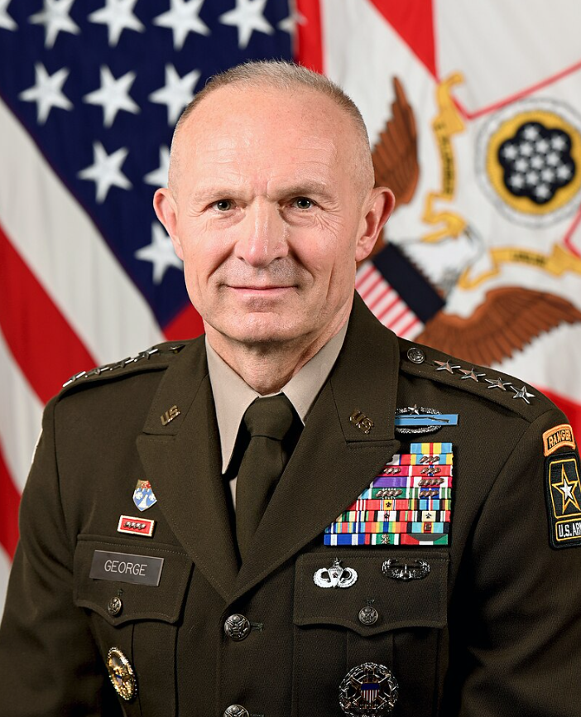
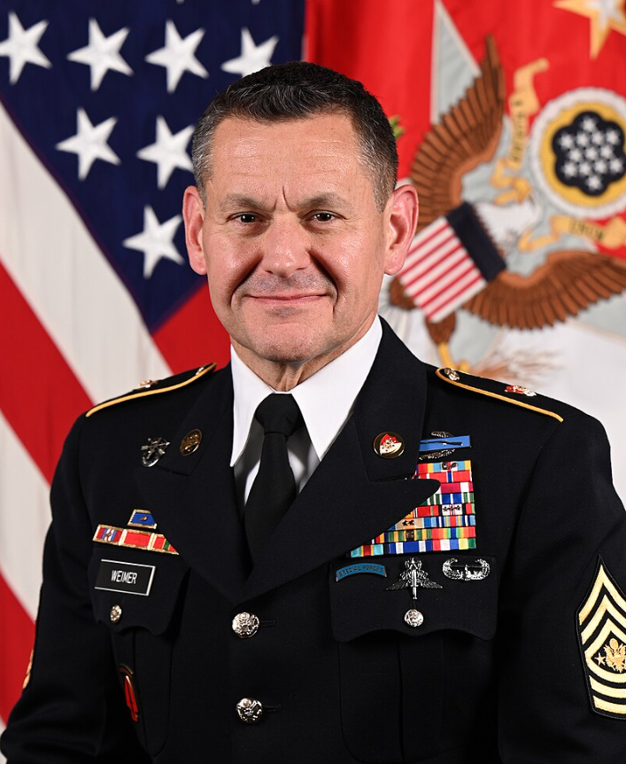
Army Leadership
Secretary of the Army
CHRISTINE WORMUTH
41st Chief of Staff of the Army
GENERAL RANDY GEORGE
17th Sergeant Major of the Army
SMA MICHAEL WEIMER
Exercises civilian control of the Army
Formulates and implements policy guidance for the Army
Resources the Army
Senior officer of the Army, primary advisor to the Secretary of the Army
Readiness of the force
Shaping the Future Army
Senior enlisted advisor to the Chief of Staff
Advocates for Soldiers

Slide 11
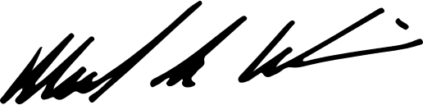

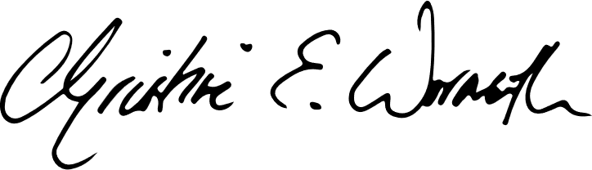
Army Focus Areas
Warfighting
“We must ruthlessly prioritize time and resources towards building lethality and cohesive teams.”
Delivering Ready Combat Formations
“We must be ready to get our formations to the fight and sustain them there.”
Continuous Transformation
“We will transform iteratively and continuously… The best ideas often come from the bottom up.”
Strengthening the Profession
“To maintain America’s trust, we must serve with competence and character.”
Michael R. Weimer
Sergeant Major of the Army
Randy A. George
General, United States Army
Chief of Staff
Christine E. Wormuth
Secretary of the Army
“Message to the Army Team – 26 October 2023,” Army.mil

Slide 12
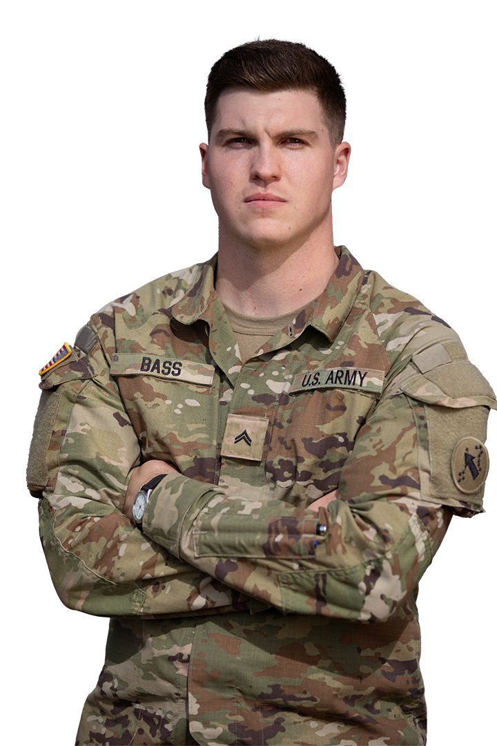
The Soldier Profession – Enlisted
Basic Combat Training
A 10-week training course that transforms Civilians into Soldiers.
Advanced Individual Training
Four to 56 weeks of hands-on training and field instruction to develop proficiency in specific career fields.
Private – Specialist
Warrior and a member of a team
Disciplined, physically and mentally tough, trained and proficient
in warrior tasks and drills
Non-commissioned Officer: Corporal – Sergeant Major
Leaders are responsible for the preparation and accomplishment of the mission and welfare and training of Soldiers
Backbone of the Army
Continually advance in expert knowledge and skills throughout their careers

Slide 13

The Soldier Profession – Officer
Basic Officer Leader Course
(Pre-Commissioning Training)
West Point
Reserve Officer Training Corps
Officer Candidate School
Basic Officer Leader Course
Provides newly commissioned Army officers with progressive and sequential training at branch schools, in order to produce adaptive officers, who are technically and tactically competent, confident and capable of leading in unified land operations.
Career Progression
Officers attend additional professional schools as they progress in their career.
Options are available to obtain advanced civilian degrees, train with foreign militaries and work with industry.

Slide 14




















Army Rank Insignia
Officers*
Warrant Officers*
Enlisted
O-1
O-2
O-3
O-4
W-1
W-2
E-1
E-2
E-3
E-4
No
Insignia
Second
Lieutenant
(2LT)
First
Lieutenant
(1LT)
18 Months
Captain
(CPT)
4 Years
Major
(MAJ)
10-11 Years
Private E-1
(PV1)
Private E-2
(PV2)
6 Months
Private First Class
(PFC)
16 Months
Specialist
(SPC)
Corporal
(CPL)
Warrant
Officer
(W01)
Chief Warrant
Officer (CW2)
2 Yrs + WOBC
30 Months
O-5
O-6
O-7
O-8
W-3
W-4
E-5
E-6
E-7
E-8
Lieutenant
Colonel
(LTC)
16.5 Years
Colonel
(COL)
22 Years
Brigadier
General
(BG)
Major
General
(MG)
Chief Warrant
Officer (CW3)
7-8 Years
+ WOAC
Chief Warrant
Officer (CW4)
12-14 Years
+ WOILE
Sergeant
(SGT)
4.5 Years
Staff Sergeant
(SSG)
8 Years
Sergeant First Class
(SFC)
12.5–14 Years
Master Sergeant (MSG)
First Sergeant (1SG)
17.7–20 Years
O-9
O-10
Special
W-5
E-9
Senior
Enlisted Advisor
Chief Warrant Officer
(CW5)
17-20 Years + WOSSE
Sergeant Major (SGM)
Command Sergeant Major (CSM)
Sergeant Major of the Army (SMA)
Lieutenant
General
(LTG)
General
(GEN)
General
of the Army
(GA)
22.6–24 Years
* Only counts commissioned time.
WOBC – Warrant Officer Basic Course
WOAC – Warrant Officer Advanced Course
WOILE – Warrant Officer Intermediate Level Education
WOSSE – Warrant Officer Senior Service Education

Slide 15
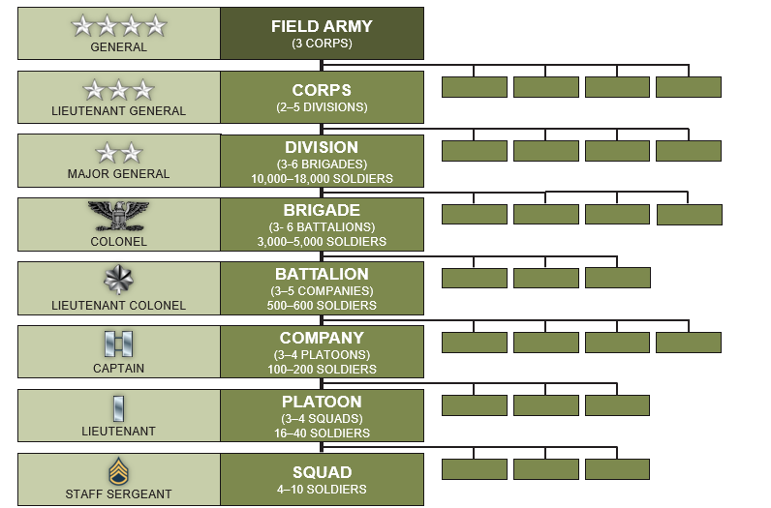
Combat Force Structure

Slide 16




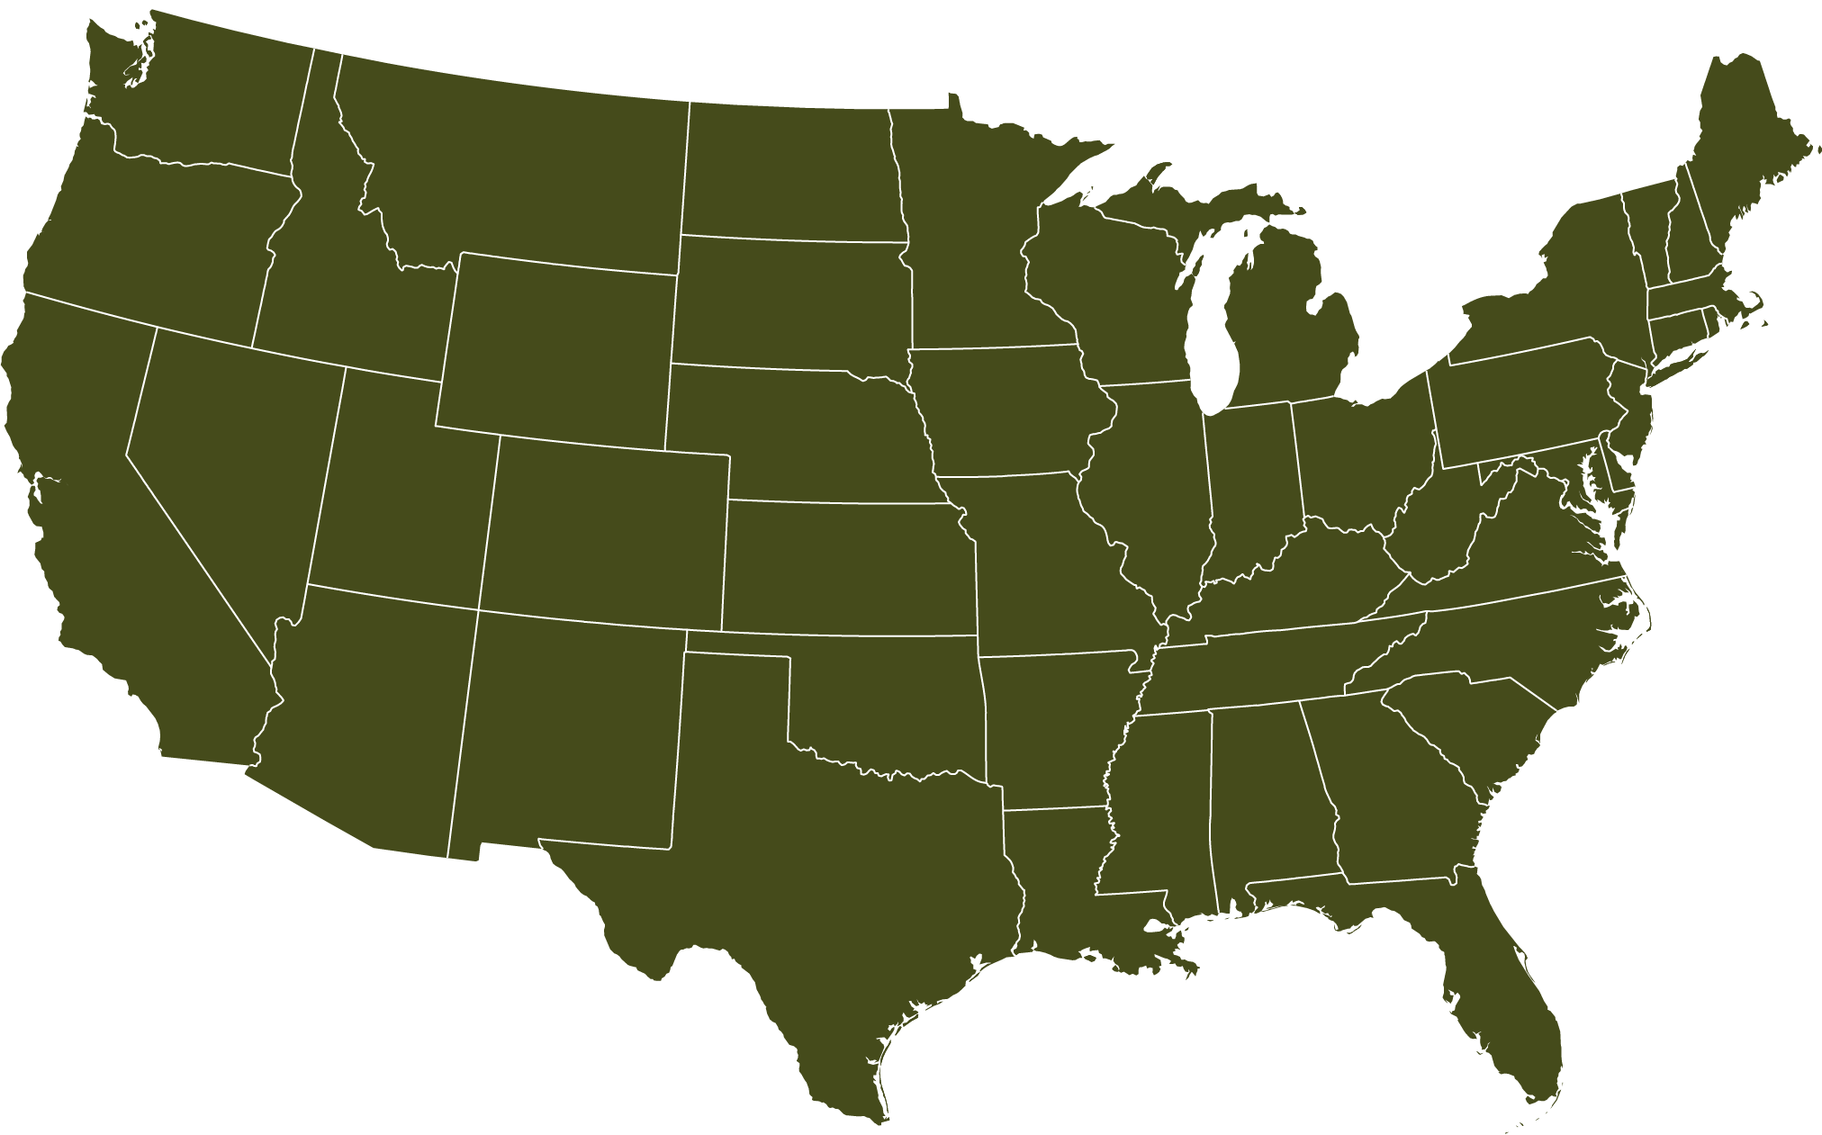


























Regular Army – CONUS-based Units
10th Mountain Division
Fort Drum, NY
11th Airborne Division
Joint Base Elmendorf-Richardson, AK
Headquarters, Department of the Army
Pentagon – Arlington, VA
U.S. Army Cyber CMD
Fort Belvoir, VA
I Corps
Joint Base Lewis-McChord, WA
101st Airborne Division
Fort Campbell, KY
U.S. Army Training
& Doctrine Command
Joint Base Langley–Eustis, VA
7th Infantry Division
Joint Base Lewis-McChord, WA
Surface Deployment & Distribution Command
Scott Airforce Base, IL
U.S. Army Central
Shaw Airforce Base, SC
82nd Airborne Division
Fort Liberty, NC
1st Infantry Division
Fort Riley, KS
U.S. Army Forces CMD
Fort Liberty, NC
4th Infantry Division
Fort Carson, CO
U.S. Army Space & Missile Defense CMD
Redstone Arsenal, AL
XVIII Airborne Corps
Fort Liberty, NC
1st Armored Division
Fort Bliss, TX
U.S. Army Special Operations Command
Fort Liberty, NC
Legend
U.S. Army Materiel Command
Redstone Arsenal, AL
Army Command
U.S. Army Futures Command
Austin, TX
3rd Infantry Division
Fort Stewart, GA
Army Corps
III Corps
Fort Cavazos, TX
Army Division
1st Cavalry Division
Fort Cavazos, TX
U.S. Army North
Fort Sam Houston, TX
V Corps
Fort Knox, KY
U.S. Army Recruiting CMD
Fort Knox, KY
Army Service
Component Command
U.S. Army South
Fort Sam Houston, TX
U.S. Army Cadet CMD
Fort Knox, KY
Human Resources CMD
Fort Knox, KY

Slide 17

















Army Reserve – Divisions & Functional Commands
200 MP CMD
Fort Meade, MD
99 RSC
JB McGuire-Dix-Lakehurst, NJ
ARCD
Fort Knox, KY
USAR Legal CMD
Gaithersburg, MD
USAR Aviation CMD
Fort Knox, KY
88 RSC
Fort McCoy, WI
MIRC
Fort Belvoir, VA
84 TNG CMD (UR)
Fort Knox, KY
76 ORC
Salt Lake City, UT
80 TNG CMD (TASS)
Richmond, VA
807 MDSC
Fort Douglas, UT
85 SPT CMD
Arlington Heights, IL
U.S. Army Reserve HQ
Fort Liberty, NC
416 TEC
Darien, IL
63 RSC
Moffett Field, CA
USACAPOC
Fort Liberty, NC
First Army SPT CMD
Rock Island, IL
108 TNG CMD (IET)
Charlotte, NC
79 TSC
Los Alamitos, CA
81 RSC
Fort Jackson, SC
75 Innovation CMD
Houston, TX
3 MDSC
Fort Gillem, GA
Legend
412 TEC
Vicksburg, MS
335 SC(T)
East Point, GA
Army Reserve Division
377 TSC
Belle Chase, LA
AR MEDCOM
Pinellas Park, FL
Army Reserve
Functional Command

Slide 18
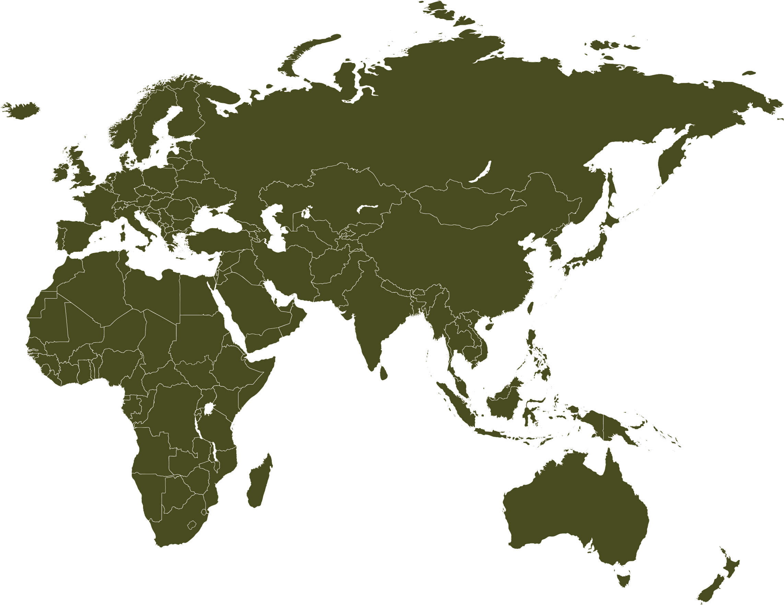












Regular & Reserve Army – OCONUS-Based Units
V Corps (Forward)
Ponzań, Poland
Eighth Army
Camp Humphreys, Korea
2^{d} Infantry Division
Camp Humphreys, Korea
U.S. Army Europe & Africa
Wiesbaden, Germany
7 MSC
Schwetzingen, Germany
U.S. Army Japan
Camp Zama, Japan
25th Infantry Division
Schofield Barracks, HI
U.S. Army Pacific
Fort Shafter, HI
Hawaii
Legend
9 MSC
Fort Shafter, HI
Army Division
311 SC (T)
Fort Shafter, HI
Army Service
Component Command
Puerto Rico
Army Reserve Division
1 MSC
Fort Buchanan, PR
Army Reserve
Functional Command

Slide 19

































Army National Guard – Divisions & Brigade Combat Teams
28th Infantry Division
Pennsylvania
29th Infantry Division
Virginia & Maryland
34th Infantry Division
Minnesota
35th Infantry Division
Kansas & Missouri
Hawaii
36th Infantry Division
Texas
38th Infantry Division
Indiana
Guam
40th Infantry Division
California
42^{d} Infantry Division
New York
Alaska
Puerto Rico

Slide 20










Regular Army – Centers of Excellence
Combined Arms Center
Fort Leavenworth, KS
Mission Command CoE
Fort Leavenworth, KS
Sustainment CoE
Fort Gregg-Adams, VA
Special Operations CoE
Fort Liberty, NC
Intelligence CoE
Fort Huachuca, AZ
Maneuver Support CoE
Fort Leonard Wood, MO
Cyber CoE
Fort Eisenhower, GA
Maneuver CoE
Fort Moore, GA
Fires CoE
Fort Sill, OK
Aviation CoE
Fort Novosel, AL

Slide 21
FY25 Army Budget Request – President’s Budget Proposal
Base Funding Program Request ($B) | FY23 Enacted | FY24 Requested | FY25* Requested
Military Personnel¹ | 68.0 | 69.8 | 70.7
Operation & Maintenance² | 70.6 | 72.1 | 71.4
Procurement/RDTE | 40.7 | 39.2 | 38.5
MILCON/Family Housing/BRAC | 4.0 | 2.8 | 3.9
Other Base³ | 1.8 | 1.7 | 1.5
Totals | 185.2 | 185.5 | 185.9
$185.9B
Request
¹ Includes Medicare Eligible Retirement Healthcare Fund
² Includes Environmental Restoration Account (ERA) Funding
³ Other Base: Chemical Agent and Munitions Destruction; Army Working Capital Fund; Arlington National Cemetery; Counter-Islamic State of Iraq/
Syria Train and Equip Fund; Afghanistan Security Forces Fund (FY22 Only)
FY 2025 Army budget allows the Army “to resource our enduring capabilities while setting the conditions for the Army of 2040.”*
The FY25 budget continues to:
  Invest in quality Soldier and family housing – Prioritize taking care of people and quality of life
  Invest in combat ready formations – Transform Army recruiting
  Deliver on modernization and innovation – Enhance capability and training in Pacific theater
  Build a more resilient industrial base*
*2025 Army FY Budget Overview

